Slide 1
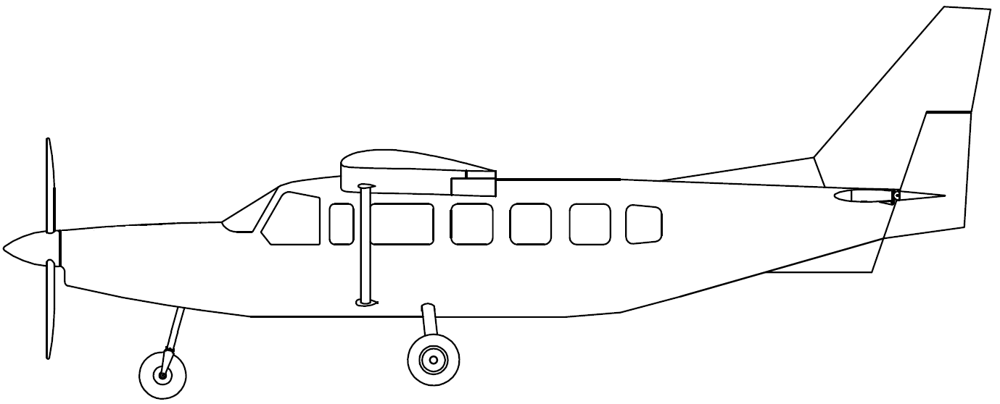



C
B
G
V
J
θ

